Slide 1
Web Application Architecture, HTTP protocol, REST
by Yuliia Tsurkan

Slide 2
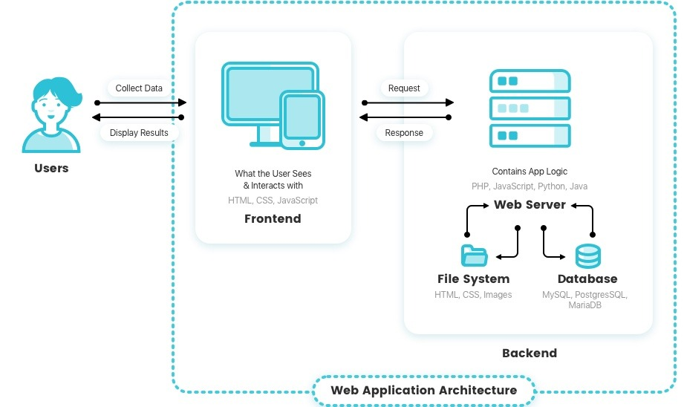

Slide 3
Web Application Components
UI/UX Web Application Components
Structural Components
Client Component
Server Component

Slide 4
Models of Web Application Components
One Web Server, One Database
Multiple Web Servers, One Database
Multiple Web Server, Multiple Databases

Slide 5
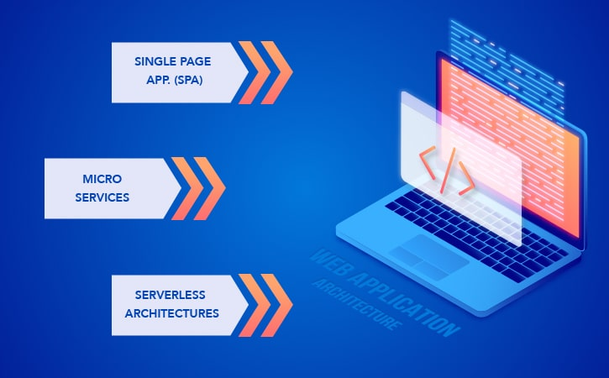
Types of Web Application Architecture

Slide 6
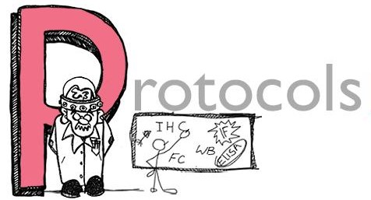
HTT
Hypertext Transport Protocol (HTTP) is a protocol that ensures transport of pages to clients.

Slide 7
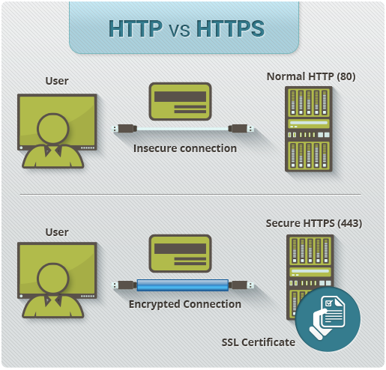

Slide 8
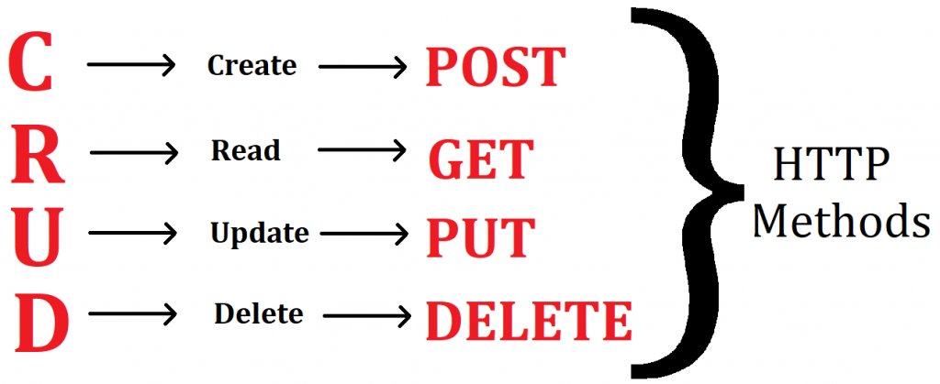

Slide 9
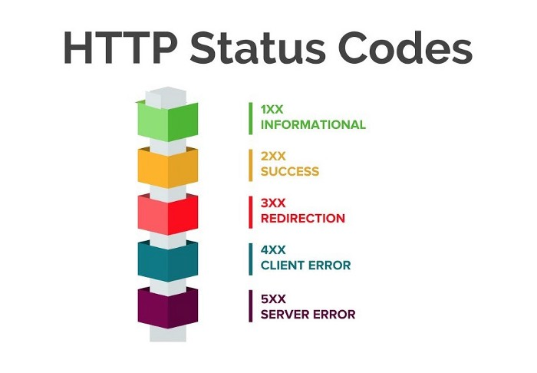

Slide 10
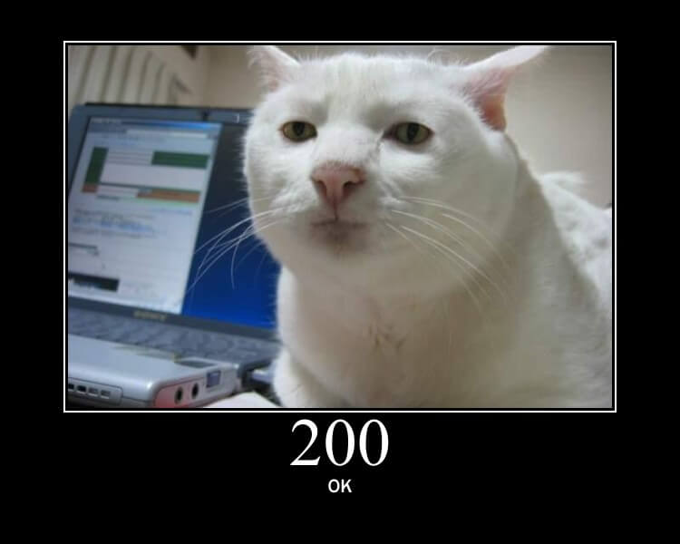
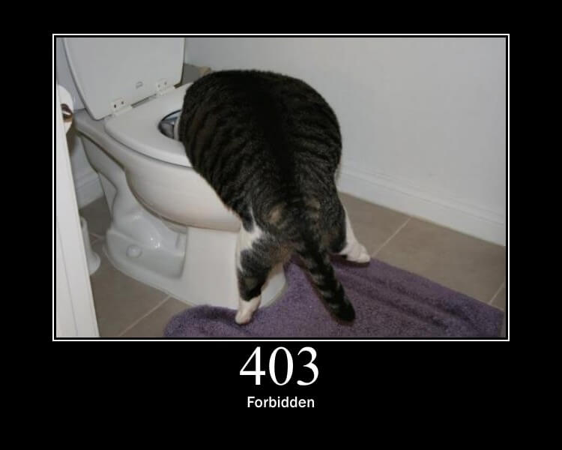

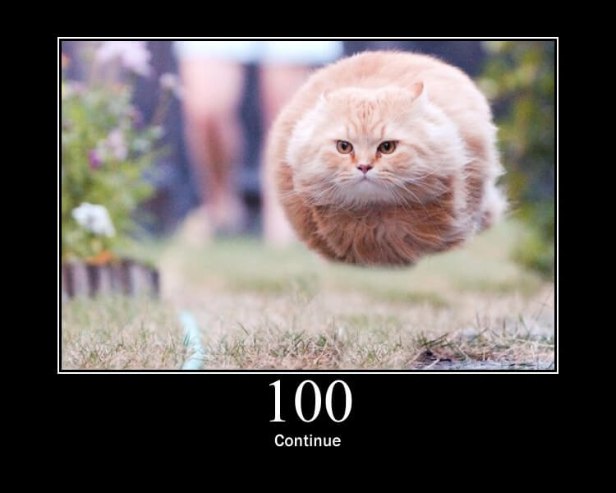


Slide 11

WHAT IS REST API???

Slide 12
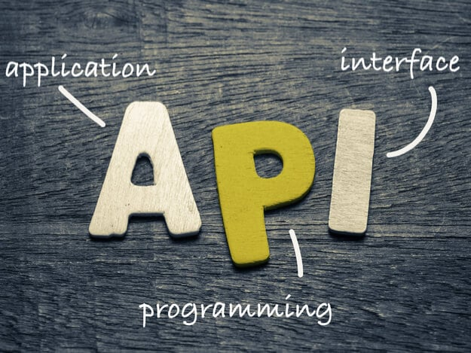

Slide 13
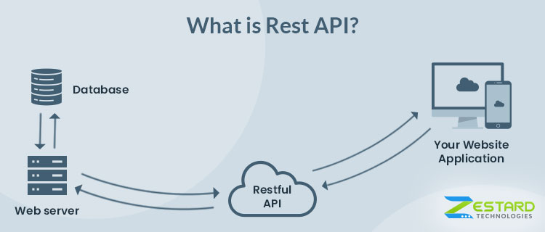

Slide 14
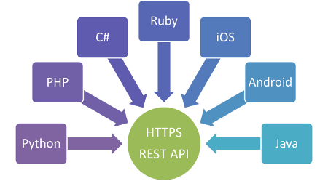

Slide 15


